Slide 1

Notes:
PLEASE NOTE THE FOLLOWING USAGE REQUIREMENTS FOR THE FIRST® DIVESM presented by Qualcomm template.
Presentations using this deck must include the FIRST DIVEcover slide (Slide 1) to ensure recognition of our presenting sponsor, Qualcomm.
Do not modify the template or overlap any of the built-in graphics.
This template uses the Roboto font family, which can be downloaded for free at fonts.google.com/specimen/Roboto
Any text use of FIRST should be in italics. Please see the FIRST Brand & Design Guidelines for more: www.firstinspires.org/brand

Slide 2
SUBMERGEDSM Awards Ceremony

Slide 3
Thank-yous

Slide 4


Slide 5

Local Sponsor
Builders of Tomorrow – The FIRST Northeast Florida Program Delivery Organization

Slide 6
Volunteer Award

Slide 7
Volunteers
No tournament can happen without the support, time, and commitment of our volunteers!

Slide 8
The Volunteer Award goes to:
{Volunteer Award}

Slide 9
The Coach/Mentor Award

Slide 10
The Coach/Mentor Award
Coaches and mentors inspire their teams to do their best, both as individuals and together, and without them, there would be no FIRST LEGO League. This award goes to the coach or mentor whose leadership and guidance is clearly evident and best exemplifies the FIRST Core Values.

Slide 11
The Coach/Mentor Award goes to:
{Coach/Mentor Award}

Slide 12
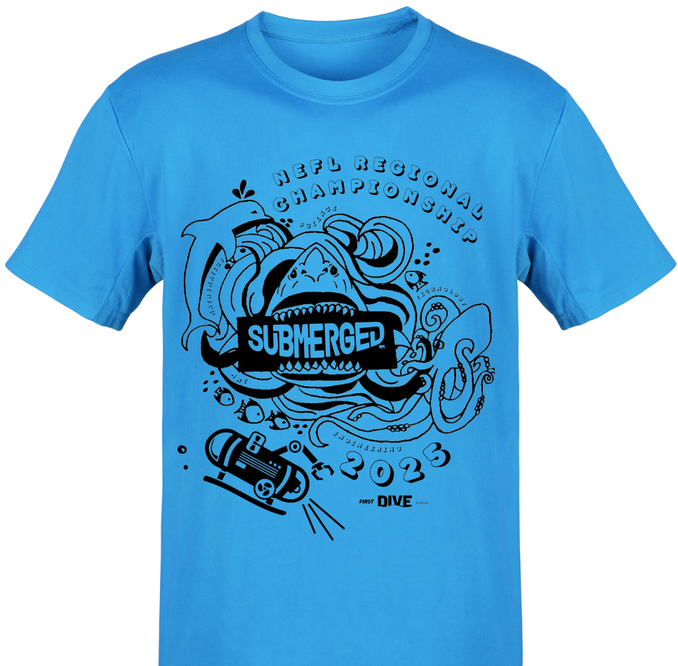
T-Shirt Design Winner
We asked teams to enter a T-Shirt Design for the Regional Championship… This season’s winner is
{T-Shirt Design}
The team wins an invitation to the Regional Championship, Friday/Saturday January 17, 18 Legacy Park Multipurpose Center in Alachua, Florida

Slide 13
Core Values Award

Slide 14
Core Values Award
This award celebrates a team that displays extraordinary enthusiasm and spirit, knows they can accomplish more together than they could as individuals, and shows each other and other teams respect at all times.

Slide 15
The Core Values Award goes to:
{Core Values Award}

Slide 16
Innovation Project Award

Slide 17
Innovation Project Award
This team utilized diverse resources for their Innovation Project to help them gain a comprehensive understanding of the problem they identified, developed a creative, well-researched solution and effectively communicated their findings to judges and the community.

Slide 18
The Innovation Project Award goes to:
{Innovation Project Award}

Slide 19
Robot Design Award

Slide 20
Robot Design Award
This team used outstanding programming principles and solid engineering practices to develop a robot that is mechanically sound, durable, efficient and highly capable of performing Challenge missions.

Slide 21
The Robot Design Award goes to:
{Robot Design Award}

Slide 22
Robot Performance Award

Slide 23
Robot Performance Award
This award celebrates a team that scores the most points during the Robot Game. Teams have a chance to compete in at least three 2.5-minute matches and their highest score counts.

Slide 24
The Robot Performance Award goes to:
Team:
{Robot Performance Award}
High Score:
{Robot Performance Score}

Slide 25
Breakthrough Award

Slide 26
Breakthrough Award
This award celebrates a team that made significant progress in their confidence and capability in both the Robot Game and Innovation Project and are a shining example of excellent Core Values. They demonstrate that they understand that what they discover is more important than what they win.

Slide 27
The Breakthrough Award goes to:
{Breakthrough Award}

Slide 28
Engineering Excellence Award

Slide 29
Engineering Excellence Award
This award celebrates a team with an efficiently designed robot, an innovative Project solution that effectively addresses the season Challenge, and great Core Values evident in all they do.

Slide 30
The Engineering Excellence Award goes to:
{Engineering Excellence Award}

Slide 31
Rising All-Star Award

Slide 32
Rising All-Star Award
This award celebrates a team that the judges notice and expect great things from in the future.

Slide 33
The Rising All-Star Award goes to:
{Rising All-Star Award}

Slide 34
Motivate Award

Slide 35
Motivate Award
This award celebrates a team that embraces the culture of FIRST LEGO League through team building, team spirit, and displayed enthusiasm.

Slide 36
The Motivate Award goes to:
{Motivate Award}

Slide 37
Champion’s Award

Slide 38
Champion’s Award
This most prestigious award celebrates the team that embodies the FIRST LEGO League experience by fully embracing the FIRST Core Values while achieving excellence and innovation in both the Robot Game and the Innovation Project.

Slide 39
The Champion’s Award goes to:
{Champion’s Award}

Slide 40
Teams advancing to Championship/World Festival/Open Invitational
Congratulations to teams (if applicable):
{Advancing Team 1}
{Advancing Team 2}
{Advancing Team 3}
{Advancing Team 4}
{Advancing Team 5}
{Advancing Team 6}
{Advancing Team 7}

Slide 41
Collect your rubrics!
Pick them up at: Location
Add any additional instructions here.

Slide 42
Congratulations, Teams!
We will see you next season!

